Slide 1
Physician in the Digital Era
Quazi Tarikul Islam
Professor of Medicine
Popular Medical College

Slide 2
EVOLUTION
of
MEDICAL SCIENCE

Slide 3
Early medical traditions include those of Babylon, China, Egypt an India.
The Greeks introduced the concepts of medical diagnosis, prognosis, and advanced medical ethics.

Slide 4
A towering figure in the history of medicine was the physician Hippocrates of Kos (c. 460 – c. 370 BCE), considered the "father of Western medicine."

Slide 5
Hippocrates

Slide 6
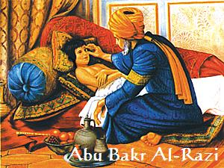
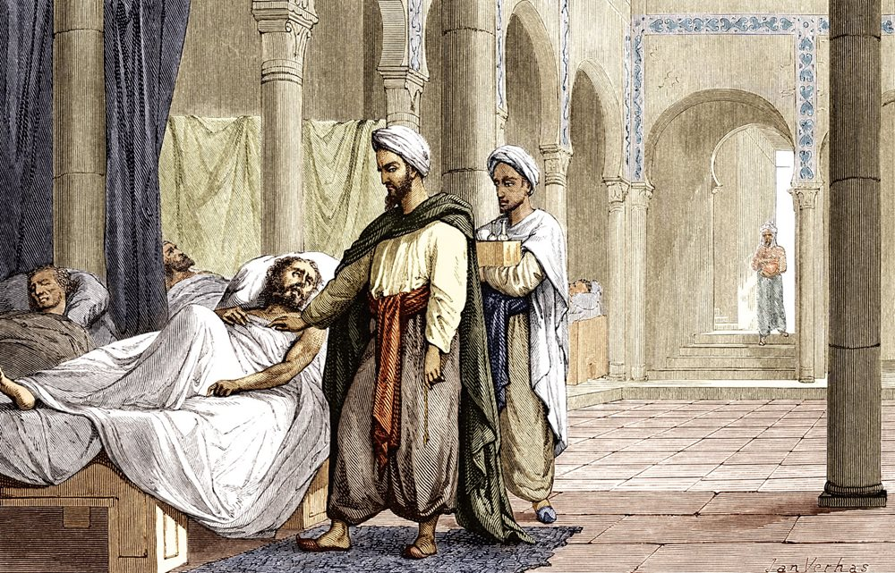
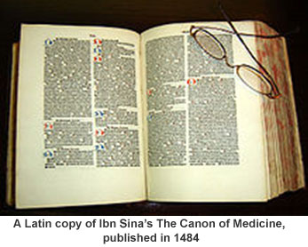
The Islamic civilization rose to primacy in medical science as its physicians contributed significantly to the field of medicine.

Slide 7
Medical School and Universities
The first medical schools - in the 9th century, most notably the Schola Medica Salernitana in Italy.
By the 13th century, the medical school at Montpellier began to eclipse the Salernitan school.
In the 12th century, universities were founded in Italy, France, and England.

Slide 8
Renaissance to Early Modern period 16th–18th century.

Slide 9
The Renaissance brought an intense focus on scholarship to Christian Europe.
The microscope was invented
The germ theory of disease in the 19th century led to cures for many infectious diseases

Slide 10
Age of Enlightenment
During the 18th-century, physicians upgraded their knowledge by becoming more scientific.
Advanced research centers opened in the early 20th century.

Slide 11
The mid-20th century was characterized by development of
Antibiotics.
Genetics
Lab technology
These advancements has led to modern medicine.

Slide 12
REVOLUTION
In
MEDICAL SCIENCE

Slide 13
What does Digital Revolution mean?
The Digital Revolution refers to the advancement of technology from analog electronic and mechanical devices to the digital technology available today.
The era started to during the 1980s and is ongoing.
Until today modern devices are coming up at Ultra, Micro and Nano technologies level.

Slide 14
Advancement has occurred in
Disease identification
Drug development
Newer diagnostic tools an machineries

Slide 15
Revolutionary change is ongoing in every sector due to technological advancement:
Medical Study
Diagnosis
Treatment
Disease Monitoring
Communication between doctor and patient
Research

Slide 16
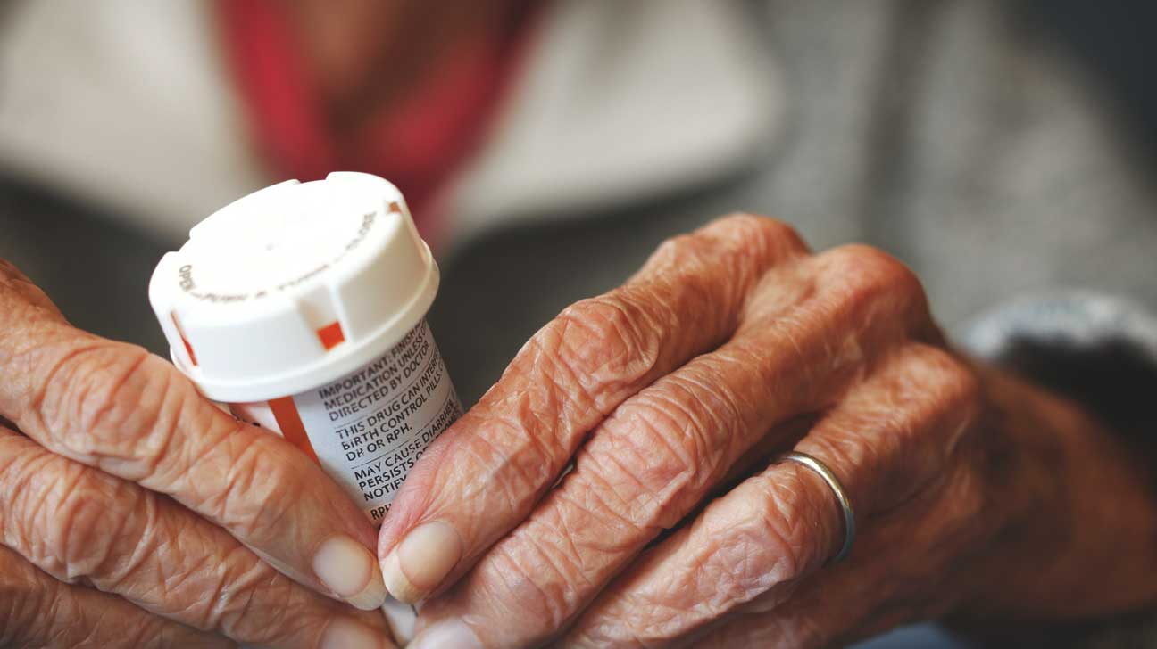
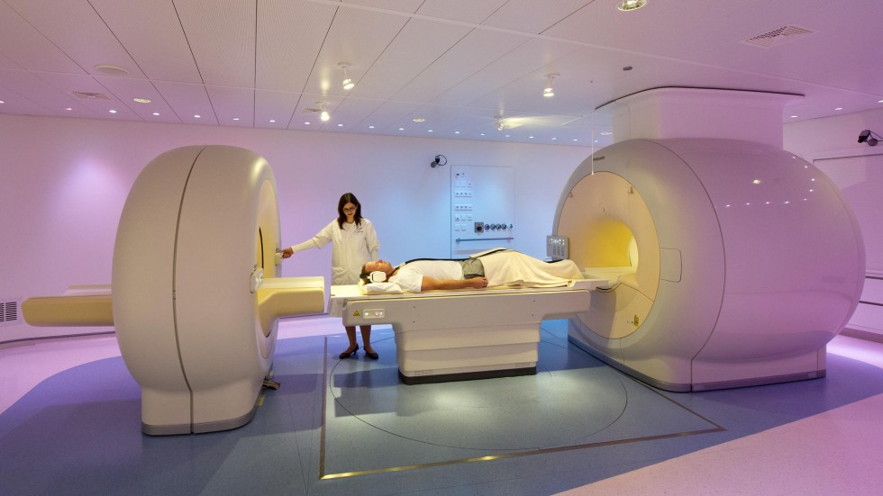
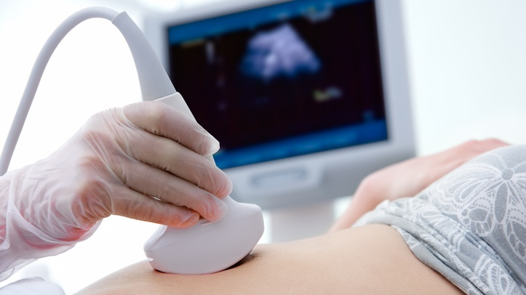
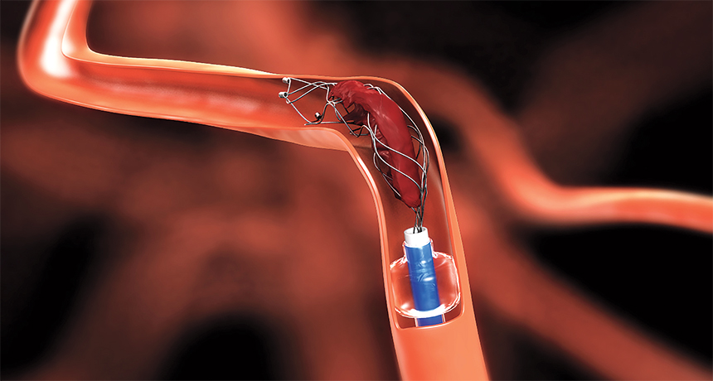

Slide 17
PHYSICIANS

Slide 18
Definition of Physician
a person skilled in the art of healing; specifically :one educated, clinically experienced, and licensed to practice medicine as usually distinguished from surgery.
WHO IS NOT A SURGEON IS A PHYSICIAN

Slide 19
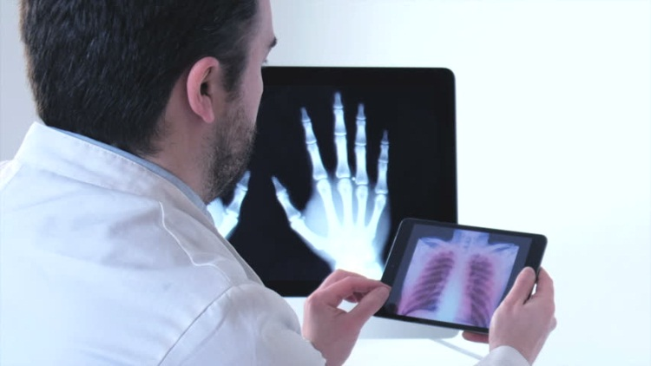
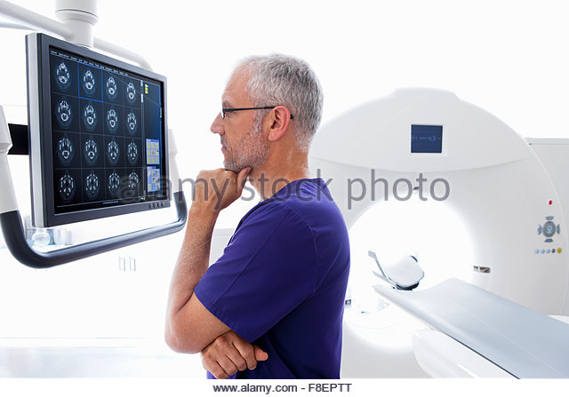
Physician in the Digital Era ( PDE)

Slide 20
Physicians of 21st century Modern Doctor Internet based doctor

Slide 21
How are they?

Slide 22
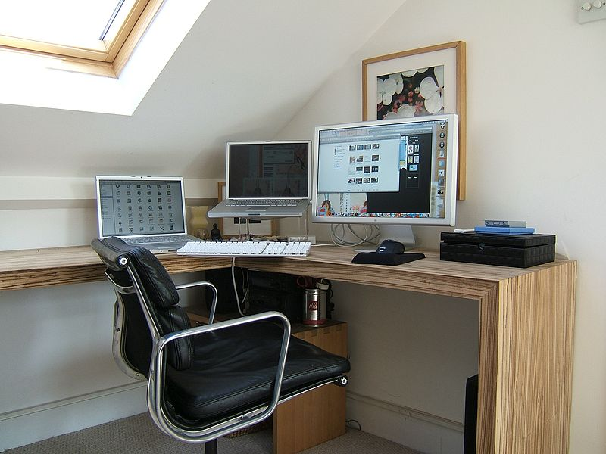
Smart with Smartphone
Equipped with newer technology

Slide 23
Greet the patient
Attentive to patient

Slide 24
Dietary advice
Information about ailment
Partnership in decision making

Slide 25
Good history taking capacity
Explain the problem accurately to patient

Slide 26
Maintains Privacy
Clarification of drugs used

Slide 27
Confidentiality
Referral if needed

Slide 28
The physician would rely on what they found by direct bed side practice of methods.
Diagnosis made after specific investigations based on clinical finding.

Slide 29
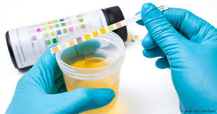

Slide 30
Sympathy and Empathy used to be the base of doctor-patient relationship.
The teamwork made diagnosis possible with minimum cost, building up confidence and reliability.

Slide 32
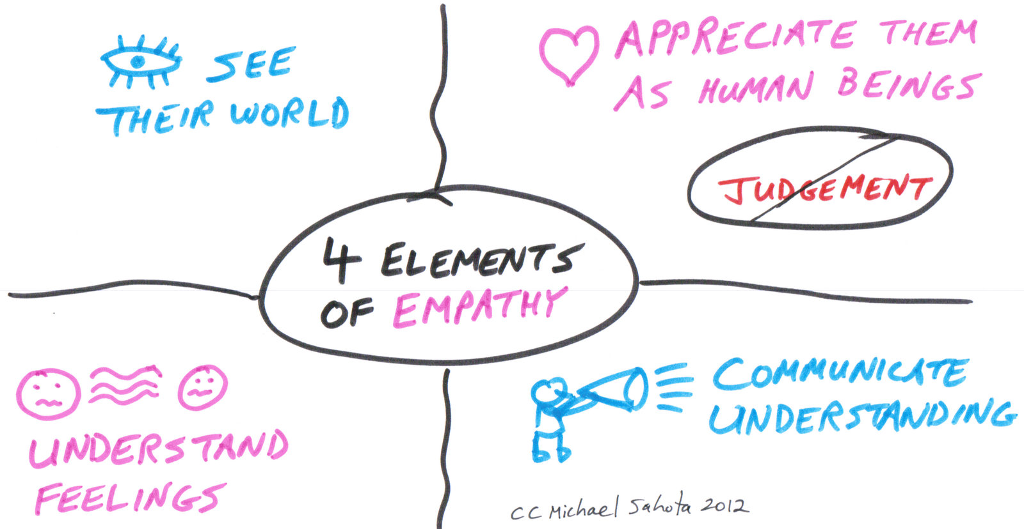

Slide 33
Patient Expectation from PDE
1. Doctors should be reachable at all times.
2. Patient care should be personalized.
3. Patients should know what’s going on at all times
4. Doctors should offer care coordination.
5. Patients shouldn’t wait to access care.
6. They demand time to verify their gathered information as they visit physicians.

Slide 35
Apart from this, patients gather knowledge about their disease, symptom, drug and tend to discuss with the physician for more clarification and possible explanation of everything- “The Wikipedia Syndrome”

Slide 36
J Bangladesh CollPhysSurg 2008; 26: 3-9

Slide 37
Current situation where major change is notable in daily activities of a doctor in different situations.

Slide 38
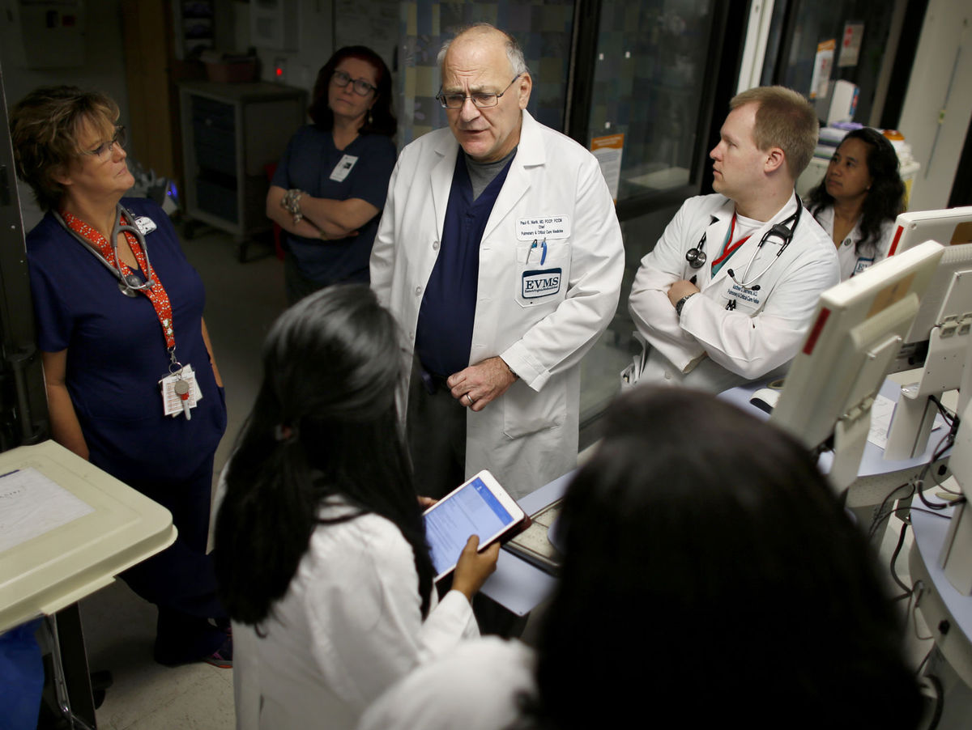
It’s a common picture in ward round

Slide 39
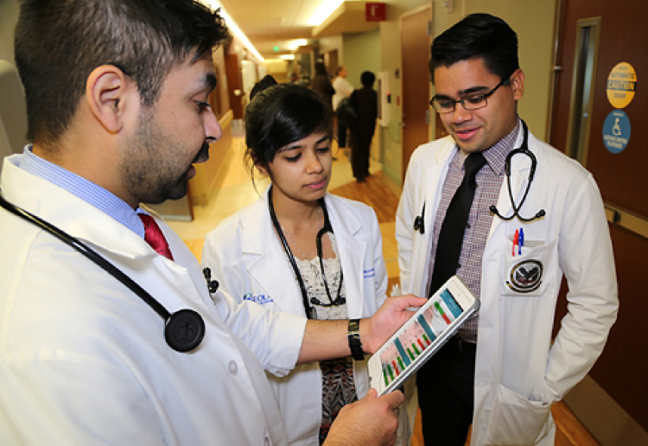
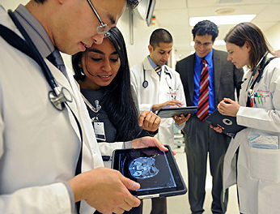
There is always someone
Holding smartphone or tabloid.
Having camera and picking academic picture

Slide 40
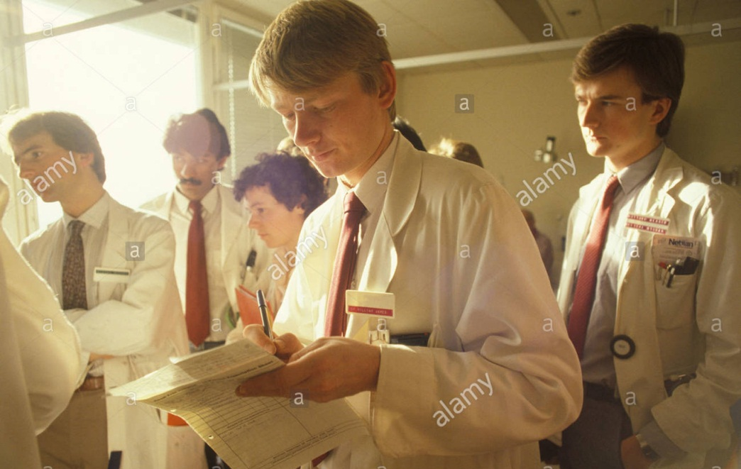
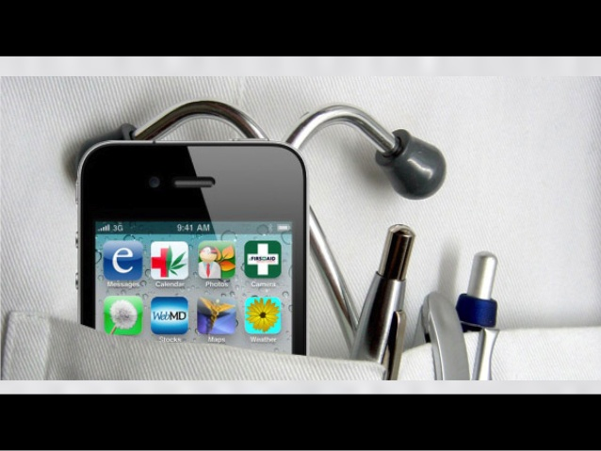
The trend of using a notebook, pencil/ pen is almost over.

Slide 41
Doctors use smartphones more than they use stethoscopes.
Both for patient care; and for socializing
Access the Internet to remain up to date
Using Medical apps

Slide 43
Teachers have to take a look at the book stored in his device before taking the class

Slide 44
Keep up to date
• Specialty-specific clinical content
• Online medical journals
Medscape, PubMed etc.
• CME articles

Slide 45
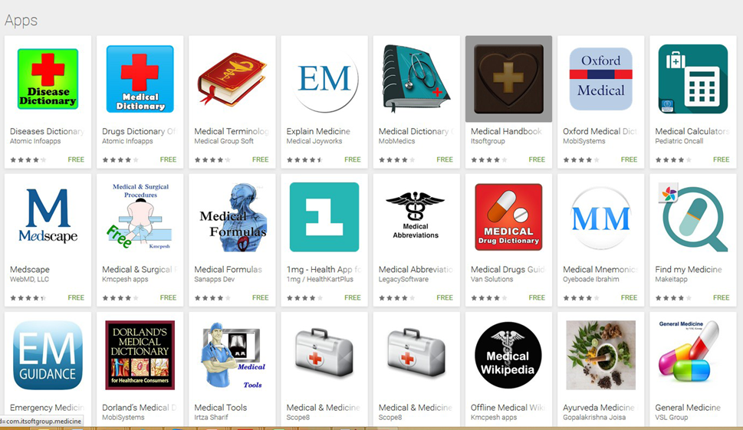
Medical apps - Reference tools act
as a peripheral brain

Slide 46
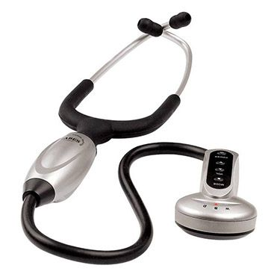
Iconic Equipment Stethoscope
Previous and Now

Slide 47
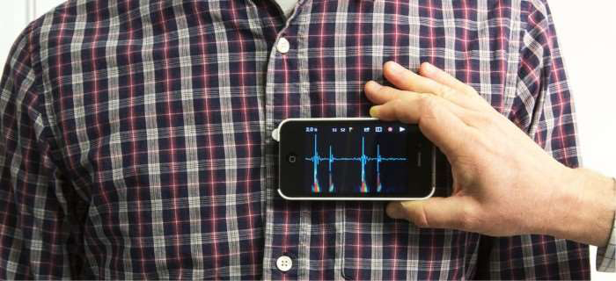
NOW !!
Smartphone Stethoscope

Slide 48
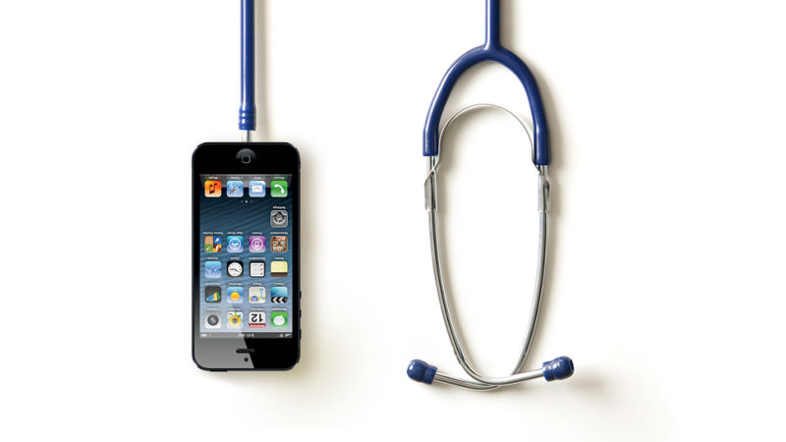
Smartphone acts like Doctors
Doctors act like Smartphone
( Vigilant, Smart, Quick , Multitasking & Ever Demanding)

Slide 49
Online websites containing articles, new information, new drugs, new disease of almost every branch of medical science and have easy to every doctor having internet facility.

Slide 50
What changes we see in daily medical practice and teaching is the reflection of improved communication and technology.

Slide 51
Internet and its improvement in dissemination has given everyone to access to vast knowledge.
Hardwire.. computer, laptop…finally smartphone revolutionized the use of internet.

Slide 52
Responsibilities of Physician Teacher/ Consultant of digital era
Teaching undergrad and post grad students
Attending Inpatients and outpatients
Grand Round
Board round

Slide 53
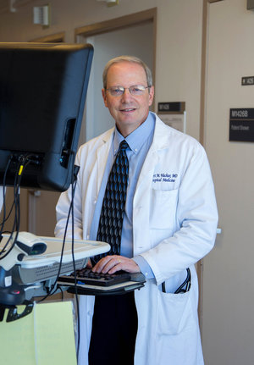
Journal Club
CME
Video conferencing
Telemedicine
Webinar
Giving feed back to patient by Cell phone
Administration

Slide 54
Carrying out Research
Writing scientific papers
Joining National and International Medical conferences
Documentation (Data base )
Death review
Medical Audit

Slide 55
Preparing national guidelines for emerging diseases
Giving health support to national disaster
All these activities are multitasking and multifaceted

Slide 56
Physicians in the Digital Era are really
BURNT OUT with their work load

Slide 57
The extensive application of modern technology has some major Disadvantages

Slide 58
Now bed side clinical examination is suppressed by increasing tendency of using diagnostic equipment.
There is significant reduction of contact between doctor and patient.
Health related cost greatly increased for the patients.

Slide 59
In the last 2 - 3 decades Medicine field has expanded a lot from its main trunk to many branches as subspecialties and sub-subspecialties.
Sub- specialty Physicians have developed tunnel vision in treating patients instead of opportunity to develop wide spectrum of knowledge.

Slide 60
Cyber Attack Spreads Across 74 Countries;
Some UK Hospitals Crippled
Published in 12 May 2017, FOX News

Slide 61
The impact of the attacks caused phone lines to go down, appointments to be canceled and patients to be turned away.
We're entering an age known as cyber-insecurity.

Slide 62
Conclusion
Physicians of Digital Era (PDE) is direct outcome of rapidly advanced technology and communication in health sector.
Substantial gains in terms of productivity and health outcomes are made possible.

Slide 63
There are prominent disadvantages in parallel to promising advantages.
Doctor-patient communication and relation become less intimate.
Physicians are being exhausted, on the other hand patient’s health cost has been increased.

Slide 64
We have to maintain pace with this digital revolution, be up to date in every way.
But also must not forget our root, the base of traditional bedside clinical practice.

Slide 65
Acknowledgement
Dr. Maksud Majumder, Registrar Medicine, PMCH
Dr. Abdul Basit Ibne Momen , Asstt. Registrar

Slide 66
THANKS
FOR
PATIENCE HEARING

